Slide 1


Department: Electrical & Computer Engineering
Course Name: Machine Learning
Course Code: CSE445
Section: 5
Semester: Summer 2025
Submitted to: Mohammad Shifat-E-Rabbi (MSRB)
Presented by:
Md. Mofidul Hassan(2231018642)
Md. Shahadat Hossain(2232195042)
Barshon Basak(2311625042)
KM Rayed Zakwan(2231678642)
01

Slide 2

INTRODUCTION:
For our project, we have chosen to develop a Face Recognition System that can identify and distinguish between 10 different individuals. The system will take input images and match them against a trained dataset using facial feature analysis and machine learning techniques. Our aim is to explore the real-world application of face recognition in areas such as security, authentication, and automation. This proposal outlines our planned approach, tools, and expected outcomes as we begin working on this project.
02

Slide 3
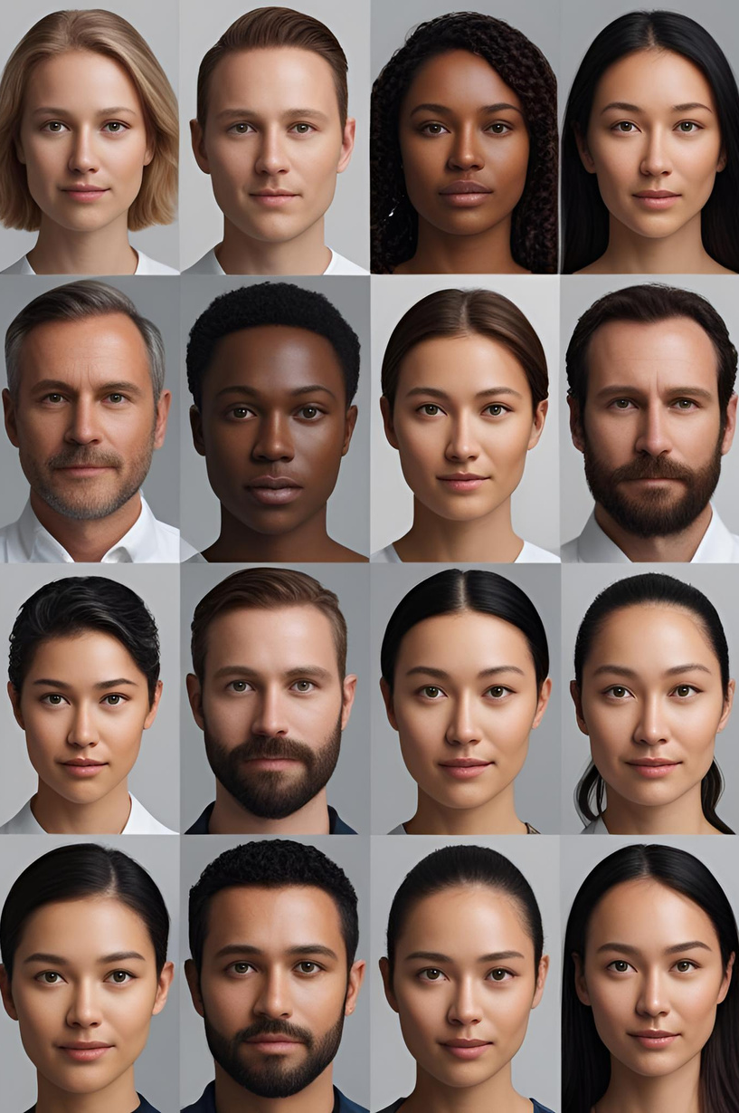
DATASET:
For this project, we will collect facial image data from 10 selected individuals. Multiple images will be captured for each person under varying lighting conditions and facial expressions to improve model robustness. After data collection, the images will be annotated and labeled with the corresponding individual’s identity. This labeled dataset will then be used to train and evaluate the face recognition model.
We will try to collect the database from internet if it meets our requirements. Else we will manually build the database.
03

Slide 4

TOOLS:
Python
The core programming language used for scripting and model development. Known for its simplicity, readability, and strong support for machine learning libraries.
Jupyter Notebook
An interactive development environment ideal for writing, testing, and visualizing code. Ideal for documentation, testing, and iterative development.
Scikit-learn
A powerful machine learning library used for data preprocessing, model evaluation, and performance tuning. Also used to implement machine learning models.
NumPy & Pandas
Useful for managing image data arrays and handling dataset structures efficiently.
Joblib / Pickle
For saving and loading trained models efficiently.
04

Slide 5

METHODOLOGY: HOW SYSTEM WORKS
Data Collection
Capture facial images of 10 individuals under varied conditions.
Ensure diversity in expressions and angles for each person.
Preprocessing
Convert images to grayscale and resize for uniformity.
Normalize pixel values to enhance model performance.
Feature Extraction with PCA
Apply Principal Component Analysis (PCA) to reduce image dimensionality.
Retain essential facial features while reducing computational complexity.
Model Training
Use the K-Nearest Neighbors (KNN) algorithm for classification.
Train the model on PCA-transformed data.
Model Evaluation
Test the model using a separate validation set.
Evaluate accuracy, confusion matrix, and prediction speed.
06

Slide 6
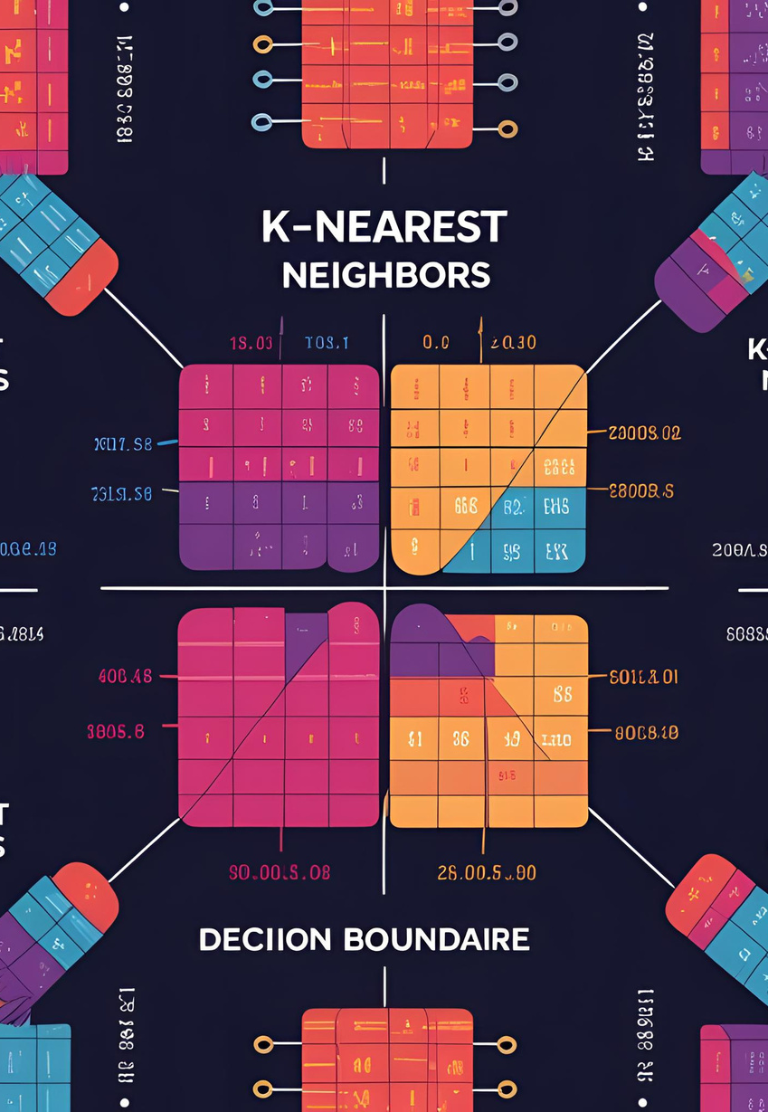
MODEL USED FOR TRAINING (KNN)
We will use the K-Nearest Neighbors (KNN) algorithm as our primary model for training.
KNN is a simple yet effective classification method that works by comparing a test image to the most similar images in the training set, making it ideal for small datasets like ours with 10 individuals.
To enhance performance and reduce computational complexity, we will apply Principal Component Analysis (PCA) for dimensionality reduction.
PCA helps retain important facial features while minimizing noise and reducing the feature space.
This combination of PCA + KNN provides a balance of accuracy, speed, and simplicity—making it well-suited for our face recognition system.
05

Slide 7
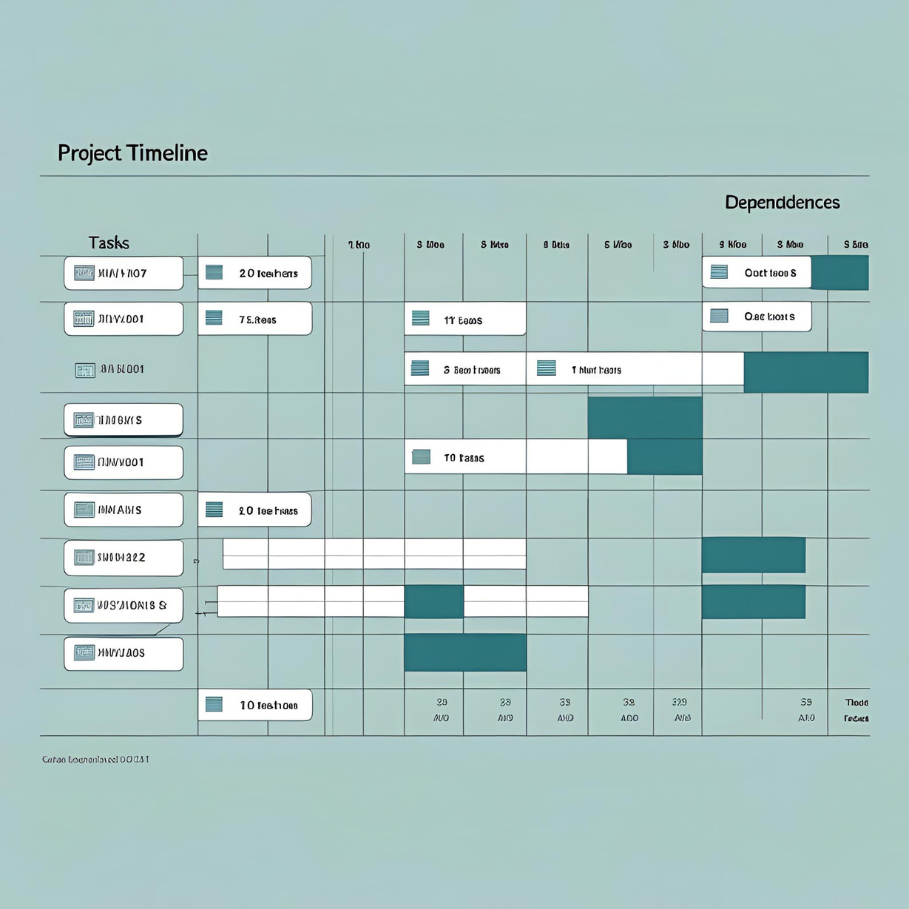
PROJECT TIMELINE
PHASE 1
PHASE 2
01
02
Collect a dataset with 10 individuals picture that will be used for our training.
Pre-process the dataset. reduce pixel and features to train better.
PHASE 3
PHASE 4
03
Train model using training data and evaluate performance using test data.
04
Build UI for users.
07

Slide 8
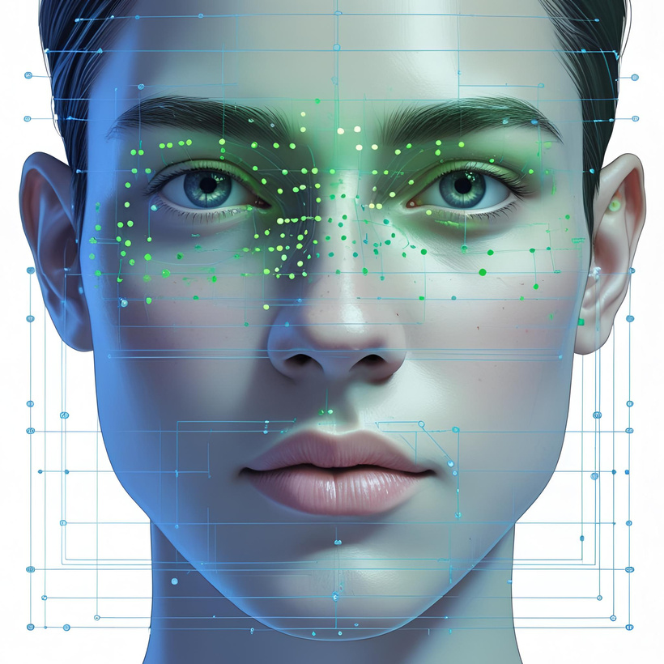
Studio Shodwe
Home
Service
About Us
Contact
CONCLUSION
This project aims to build a reliable and efficient face recognition system capable of identifying 10 individuals using a combination of PCA for feature reduction and KNN for classification.
We are confident that this model will meet our project objectives and provide a strong foundation for further enhancements in the future.
08

